Slide 1
Multi-Augmentation Strategy for Self-Supervised Learning
Tran Van Nhiem

Slide 2
Proposed Content
1.
2.
Disentangle (Representation Learning)
Data Augmentation Overview
Supervised- Self Supervised
3.
4.
Proposed Multi-Augmentation Strategies.
Proposals Method Pipeline
5.
Proposal Method Schedules – Expected Results

Slide 3
1.
Disentangled Representation
(Self-Representation Learning)

Slide 4
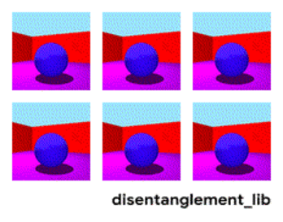
Disentangled Representation
Visualization of the ground-truth factors of the Shapes3D data set: Floor color (upper left), wall color (upper middle), object color (upper right), object size (bottom left), object shape (bottom middle), and camera angle (bottom right). Image source: Link

Slide 5
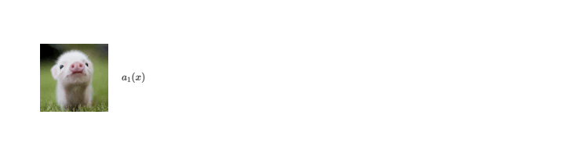
Disentangled Representation
Data Augmentation
Color Representations
Image source

Slide 6
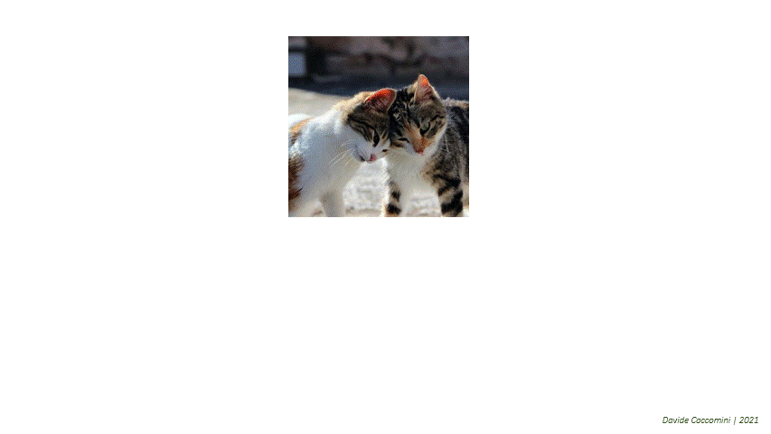
Disentangled Representation
Data Augmentation
Local – Global Semantic Representations
Image source

Slide 7
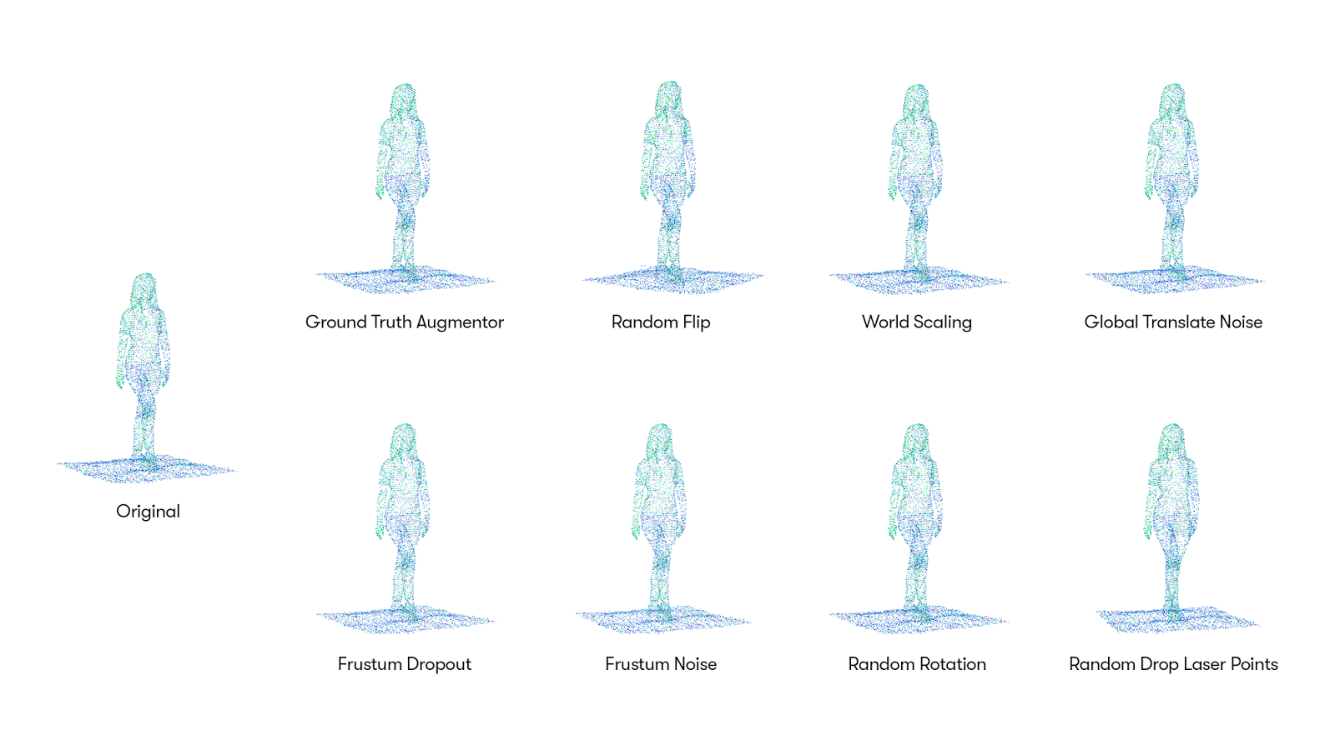
Disentangled Representation
Data Augmentation
Shape – Size – Geometric Representations
Image source: Link address

Slide 8
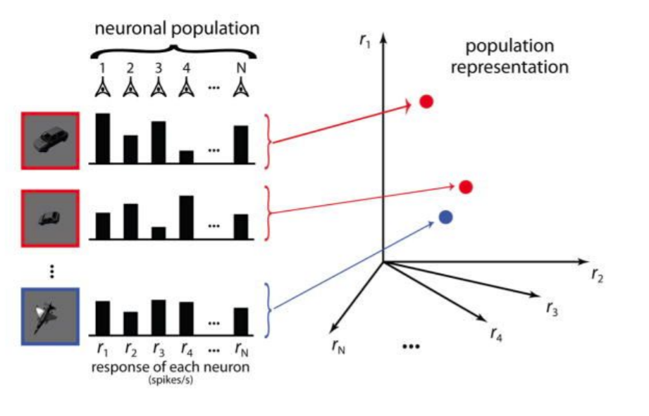
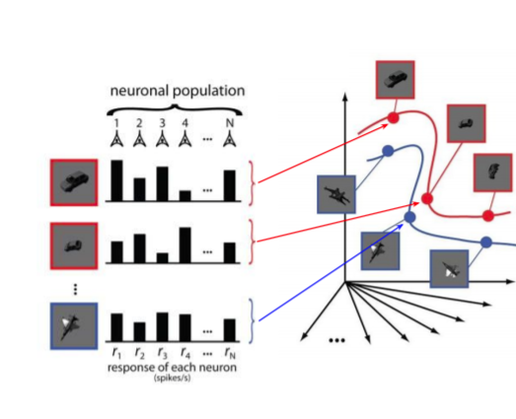
Untangling representations
High dimensions of the variant of input signals
Inputs signals
This will make problem much harder when the inputs now increasing at scales
Image Source

Slide 9
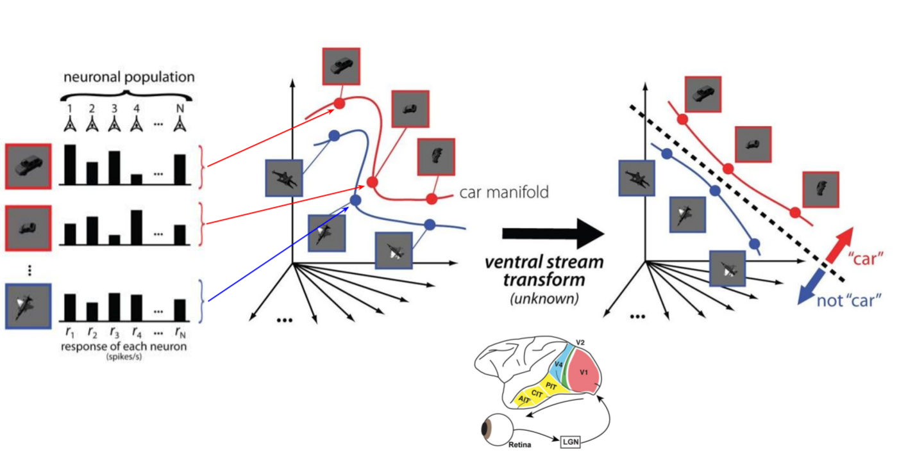
Untangling representations
Image Source

Slide 10
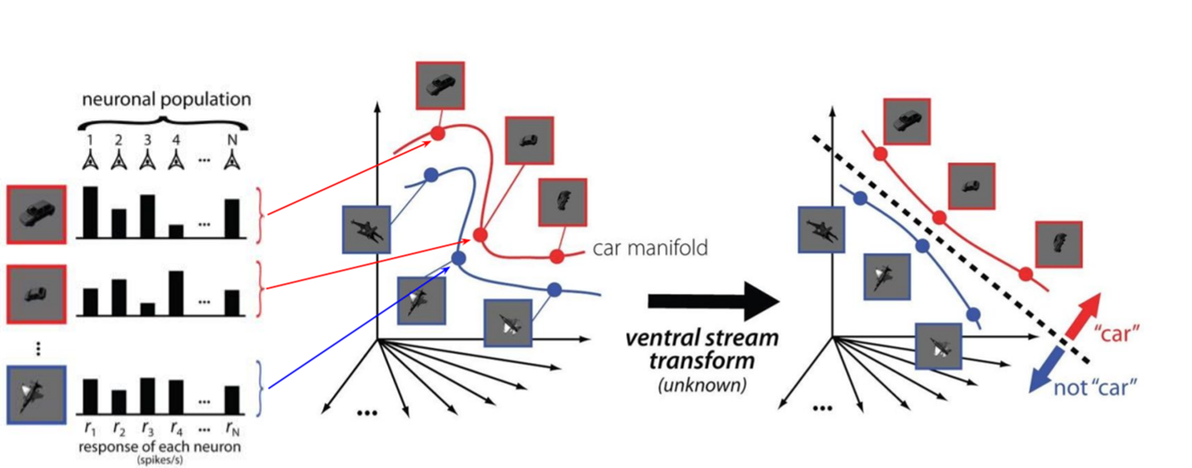
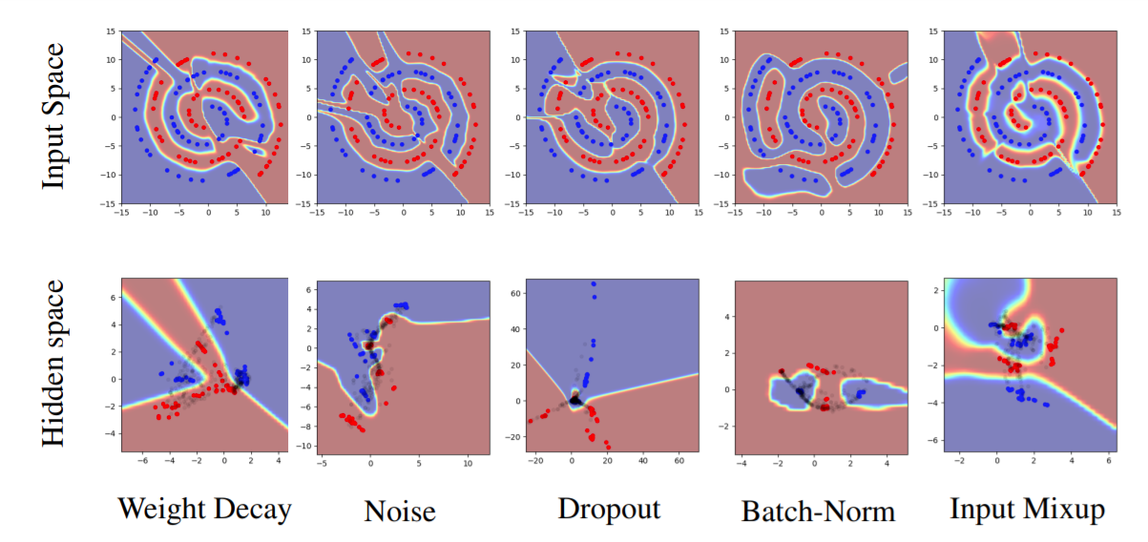
Untangling representations
Current REGULARIZATION techniques seem to helps Smooth the hard boundary and push the population close together
Image Source

Slide 11
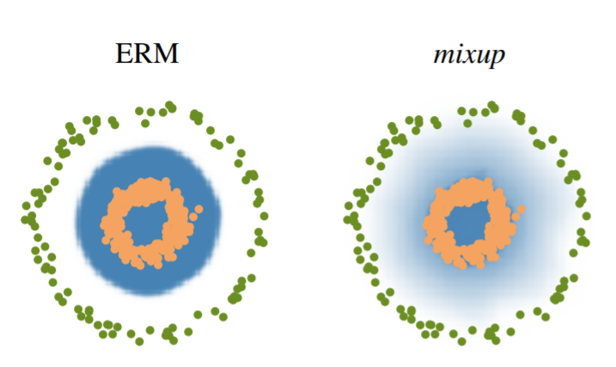
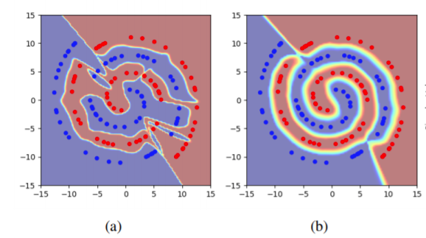
Untangling representations
Current REGULARIZATION techniques seem to helps (Mixup, up Manifold-Mixup, Others) Smooth the hard boundary and push the population close together
Image Source
Image Source

Slide 12
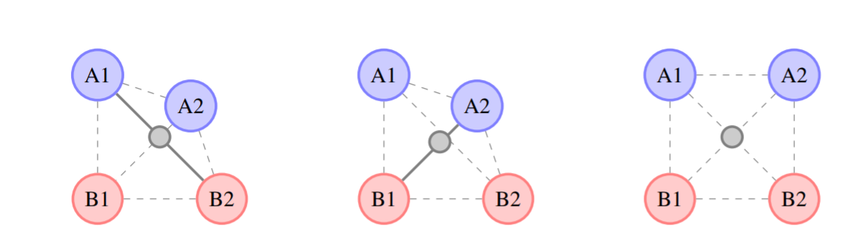
Untangling representations
Current REGULARIZATION techniques seem to helps (Mixup, up Manifold-Mixup, Others) Smooth the hard boundary and push the population close together
Image Source

Slide 13
Task1
Task2
Task3
……
Task N
What makes good representation Learning ?
Representation
Deep Neural Net
Inputs 1
……
Inputs N

Slide 14
2.
Data Augmentation Strategy
Supervised & Self-Supervised
Literatures Overviews

Slide 15
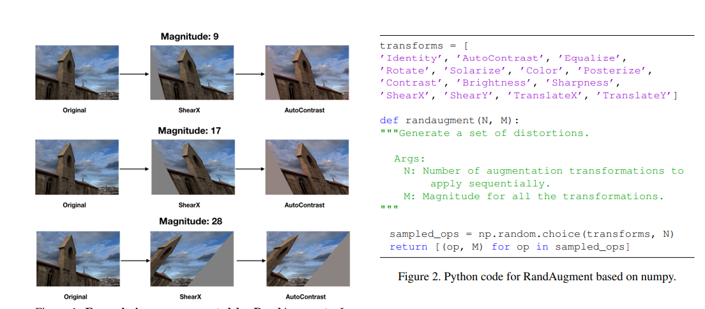
Supervised Learning –Data Augmentation
Random Augmentation
Transformations &Magnitude (T=2, M=7) [T (0-14) M(0-30)

Slide 16
Random Search Strategy
Random Search picks the point randomly from the configuration space.
Hyperparameter 2
Hyperparameter 1

Slide 17
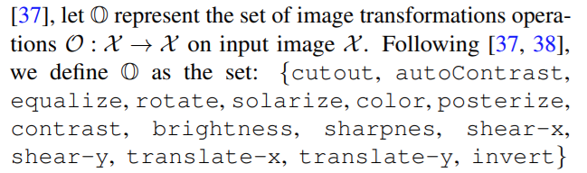
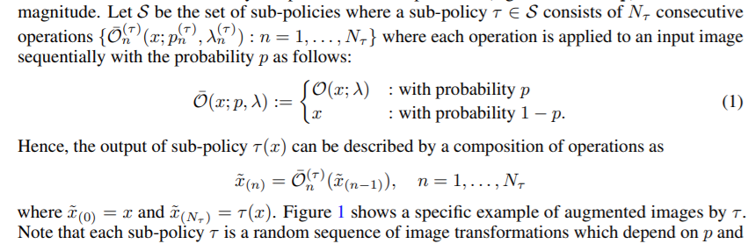
Supervised Learning –Data Augmentation
Policy Bayesian optimization Search

Slide 18
Bayes’ Theorem
Supervised Learning –Data Augmentation
P(a | b) = P(a) P(b | a)
P(b)
posterior
prior
likelihood
marginal likelihood

Slide 19
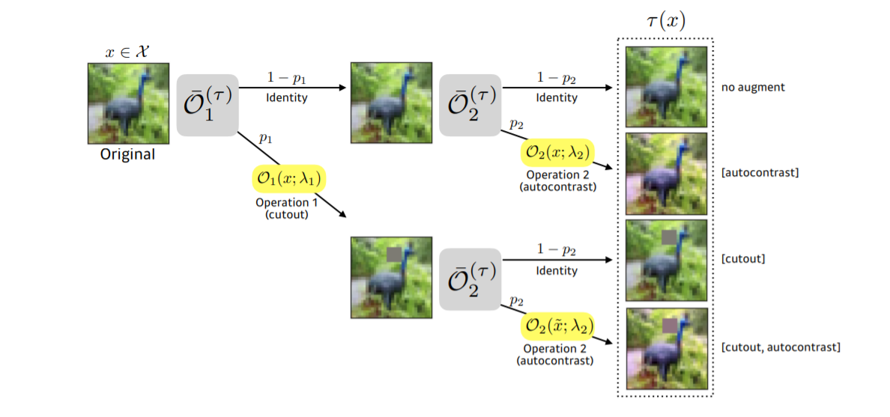
Supervised Learning –Data Augmentation
Policy Bayesian optimization Search
Fast Auto Augmentation

Slide 20
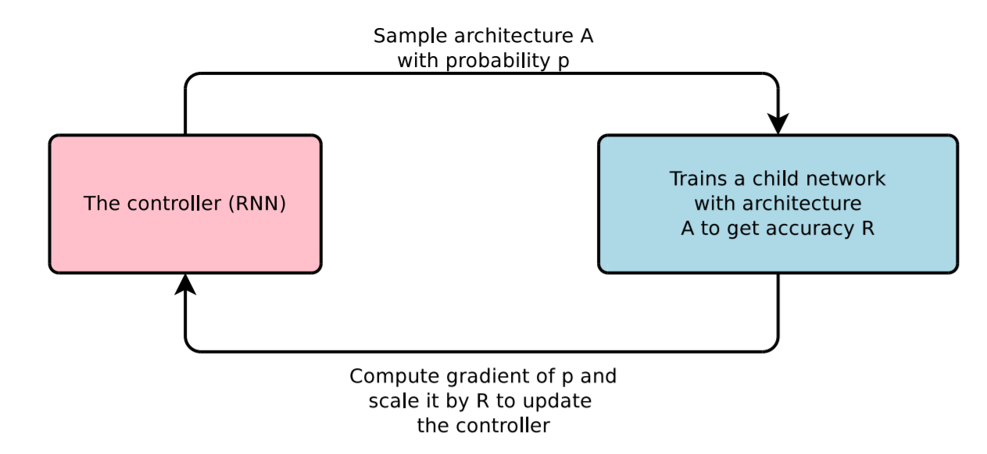
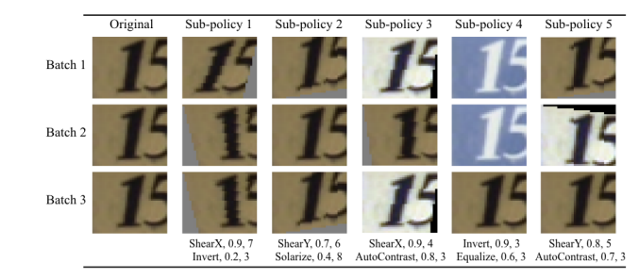
Supervised Learning –Data Augmentation
Auto Augmentation
Neural Architecture Search with Reinforcement Learning (Policy Gradient) Zoph & Le ICLR, 2017

Slide 21
Reinforcement Learning Algorithm
RNN -- LSTM
Sample models A with probability p
Controller
Trainer
Iteration N times find the best Policies
Accuracy
Reward
Compute Gradient of P and scale it by R to update the controller

Slide 22
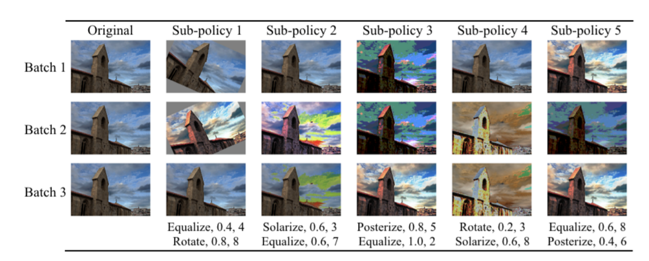
Policy Strategy Auto Augmentation Data-Augmentation
Reinforcement Learning

Slide 23
Benchmark Methods

Slide 24
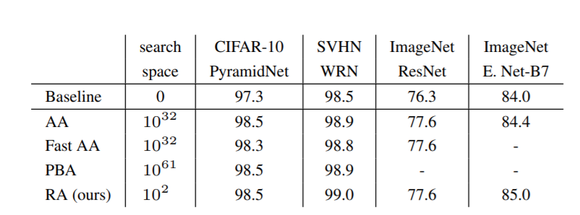
Bench Mark Result These Strategies
Image source

Slide 25
1. What We Can Learn From Supervise Learning Searching Data Augmentation ???

Slide 26

1. Handcrafted Vs Random Search Strategy
Grid Search
Random Search

Slide 27
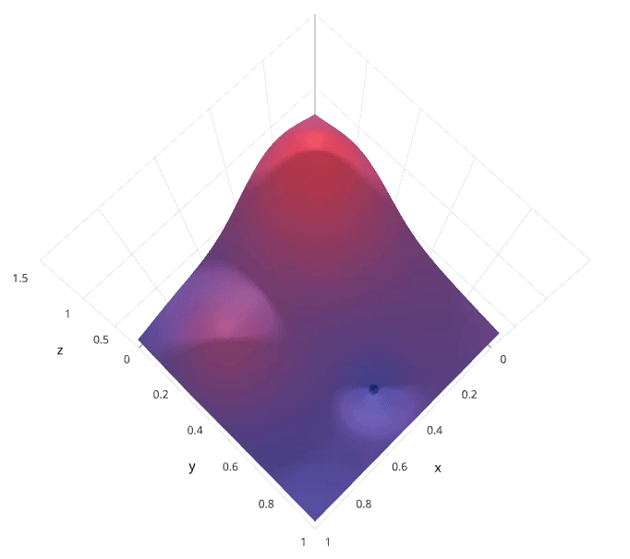

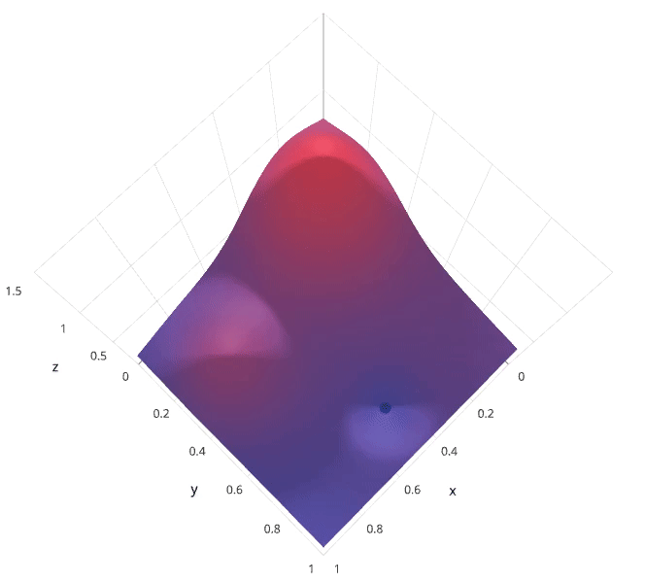
Comparison Bayesian Optimization vs Grid and Random Search
Grid Search
Random Search
Bayesian Optimization
Image source: Link access

Slide 28
2. What are important transformation From Supervise Learning Data Augmentation ???

Slide 29
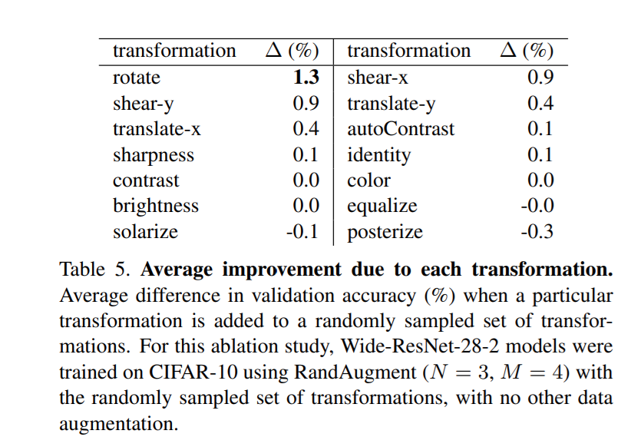
Supervised-Learning Important transformation
Random Apply
Image source

Slide 30
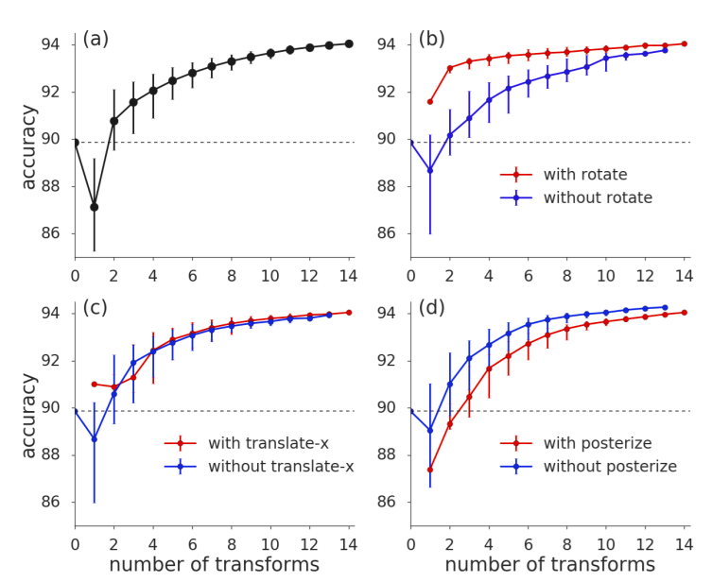
The efficiency of method in Performance Implementation
Random Apply
Image source

Slide 31
The efficiency of method in Performance Implementation

Slide 32
2. What are effective implementations methods From Supervise Learning Data Augmentation ???

Slide 33
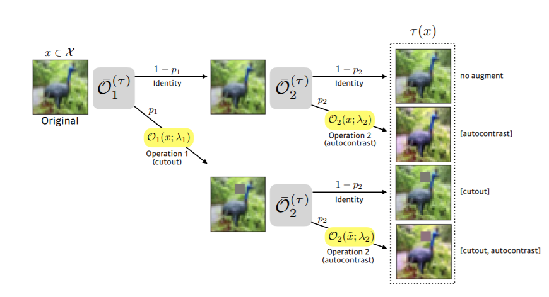
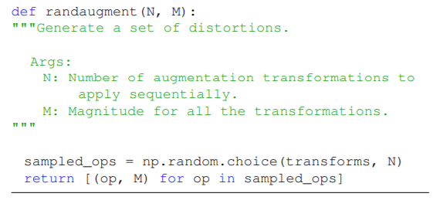
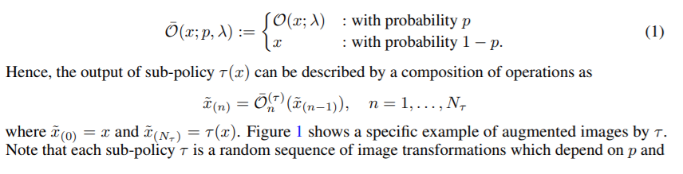
Effective methods implementation
Random Choices
Probability (optimization) Choices

Slide 34
Supervised Learning – Data Augmentation -
Regularization

Slide 35
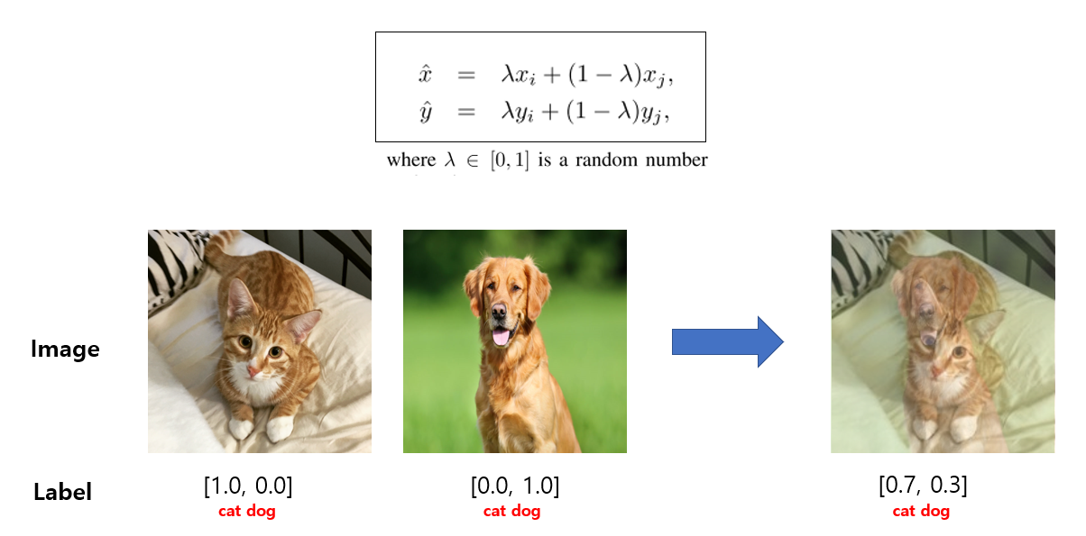
Supervised Learning – Data Augmentation Regularization
Mixup Augmentation -Regularization
Image Source

Slide 36
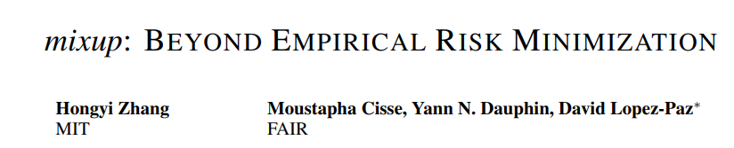
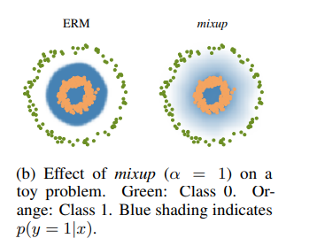
Supervised Learning – Data Augmentation Regularization
Mixup Augmentation -Regularization
Mixup Paper
Image Source

Slide 37
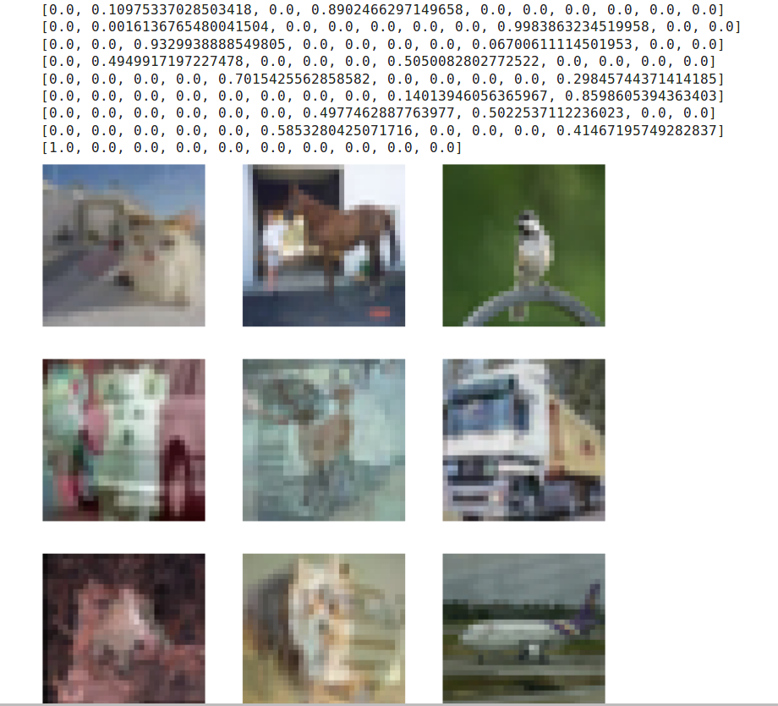
Mixup Experiement in Cifar 10

Slide 38
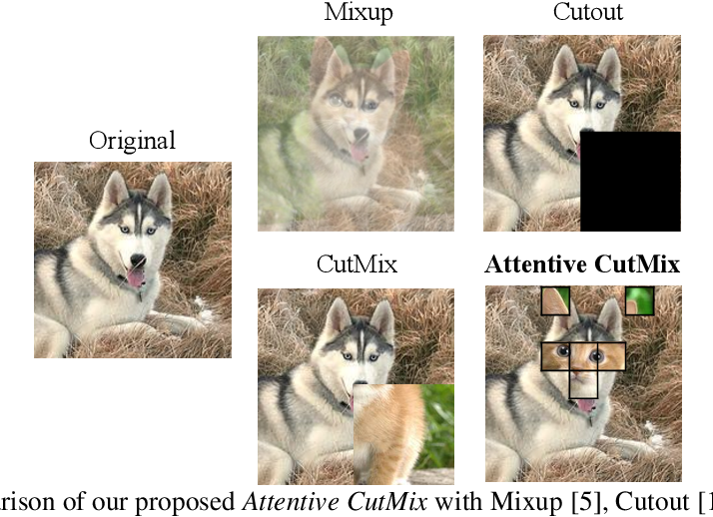
Supervised Learning – Data Augmentation Regularization
Cutout, CutMix Data Augmentation
CutMix Paper

Slide 39
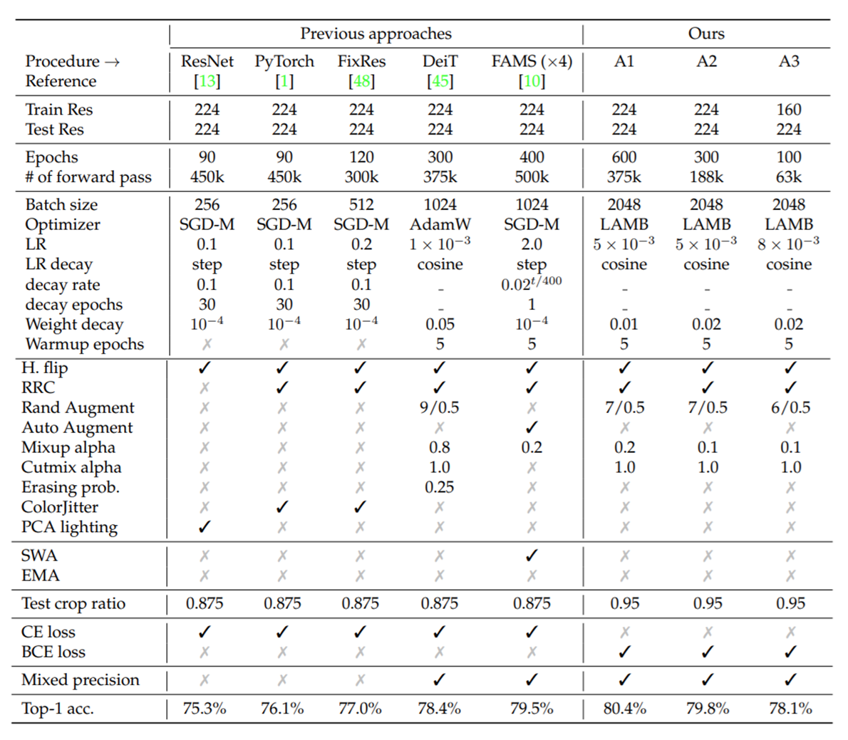
Augmentations + Regularizations
ResNet strikes back: An improved training
procedure in timm 2021 et al.

Slide 40
Current Self-Supervise Learning Data Augmentation

Slide 41
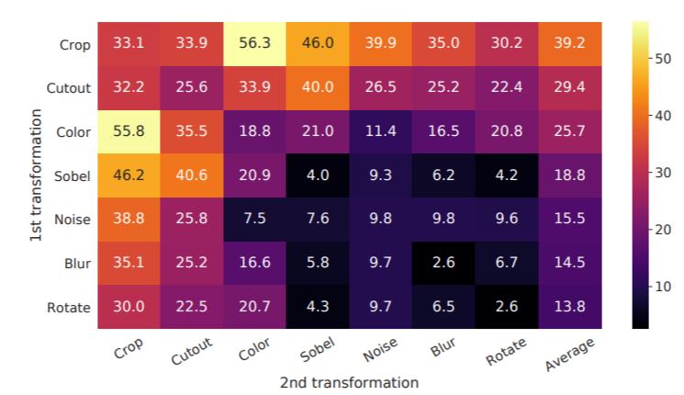
Handcrafted SimCLR Data-Augmentation
SimCLR (Positive –Negative) Augmentation Strategy
Dataset working: Natural Images (ImageNet, CoCo, Others)
Apply Single Transformation
Apply Sequential 2 Transformations
BYOL, SimSam– Base on SimCLR [None – Contrastive (Positive Pair Only)]

Slide 42
Self-Supervised – Searching Strategy Data Augmentation
SelfAugment: Automatic Augmentation Policies for Self-Supervised Learning Reed et al. 2021
Bayesian Optimization –Self-Supervised Learning
Fast Auto Augmentation

Slide 43
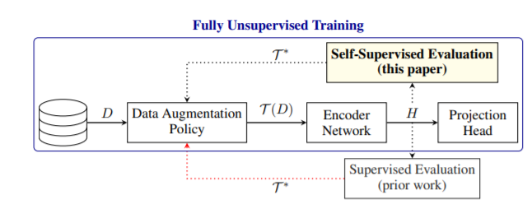
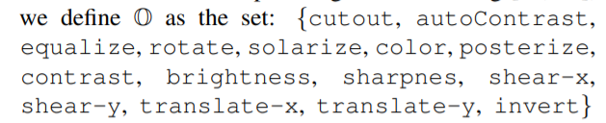
Policy Strategy Auto Augmentation Data-Augmentation
Using Random Augmentation Population

Slide 44
2. What are important transformation From Supervise Learning Data Augmentation ???

Slide 45
Cropping – Random Color distortion
Apply Single Transformation
Apply Sequential 2 Transformations

Slide 46
Under Review

Slide 47
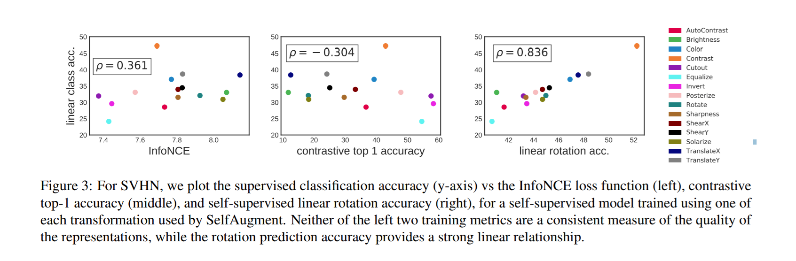
Transformation impact in self-Supervised

Slide 48
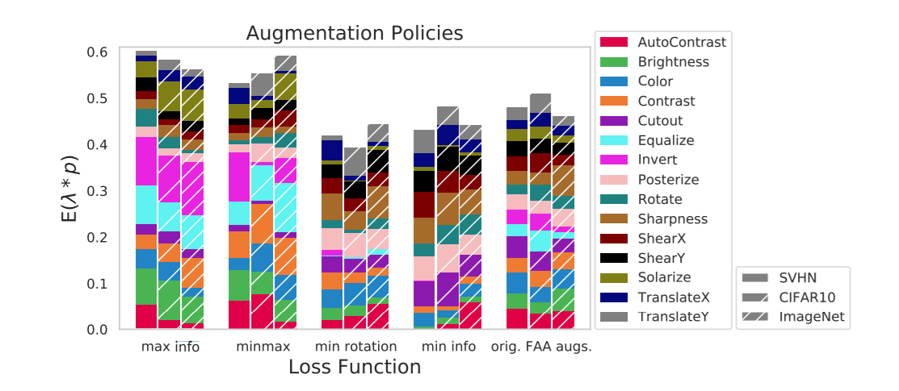

Slide 50
Multi-Crop Strategy [Global & Local ] SSL Augmentation
Image source

Slide 51
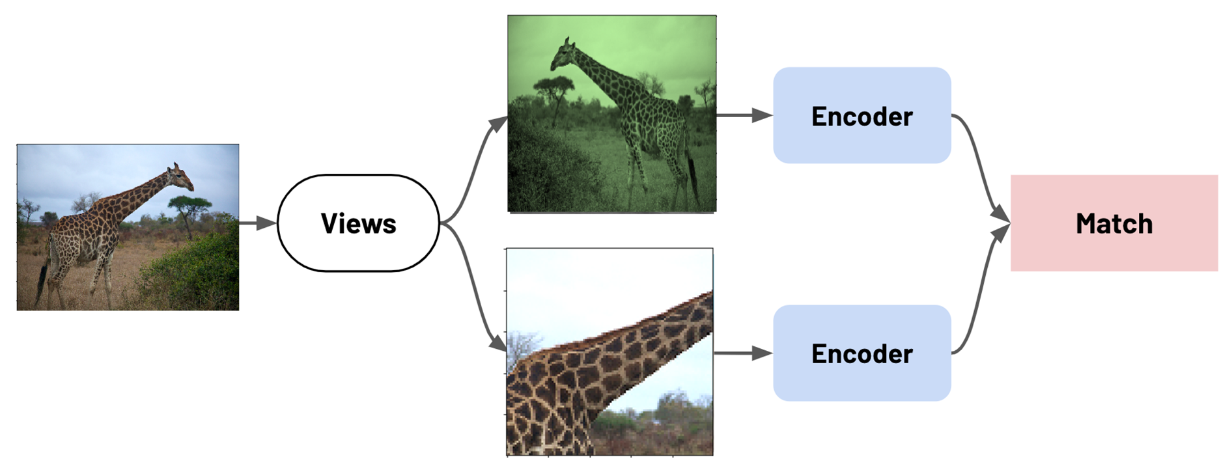
Two views approach Contrastive Self-Supervised

Slide 52
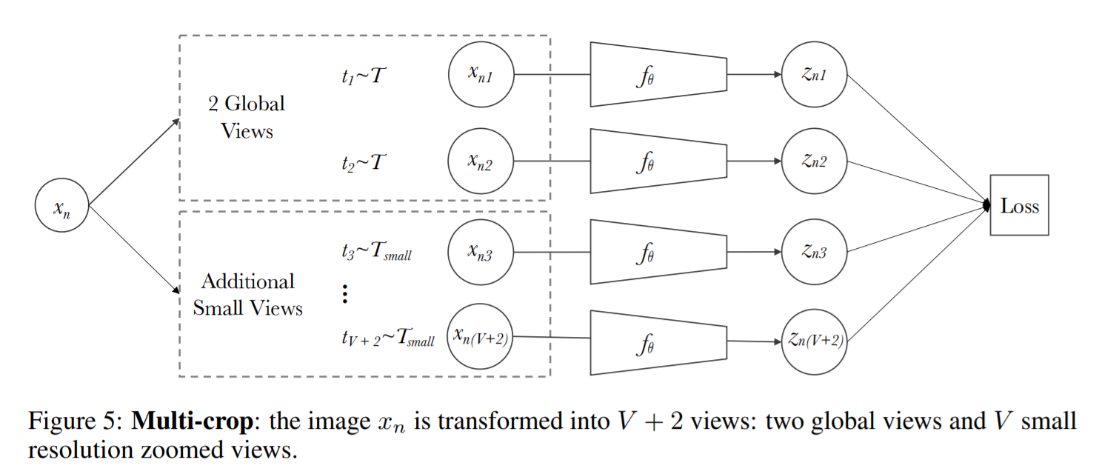
Multi-Views Strategy [Global & Local ] views
Image source

Slide 53
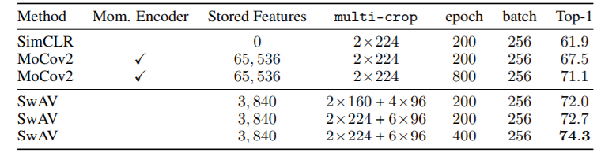
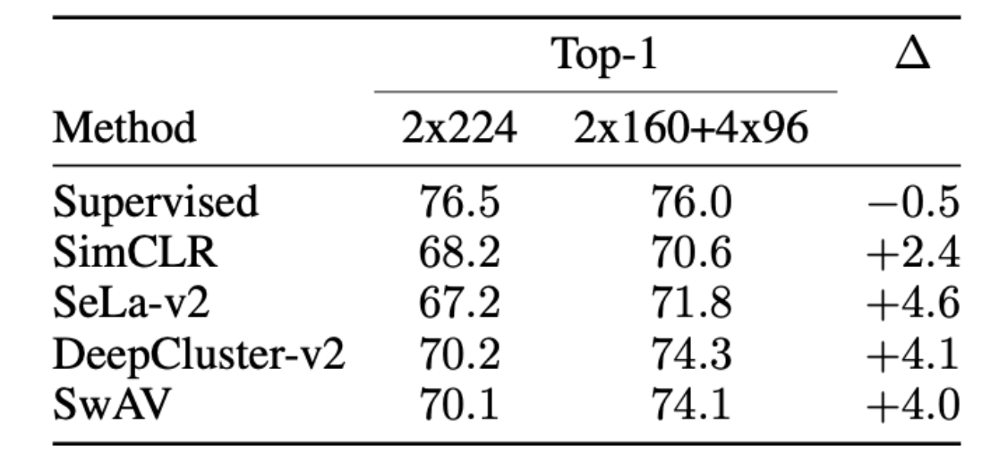
Multi-Views Augmentation Yield better Result
Image source

Slide 54
2. What We Can Learn From Self-Supervise Data Augmentation ???

Slide 55
Cropping + Color Distortion are important in SSL learning

Slide 56
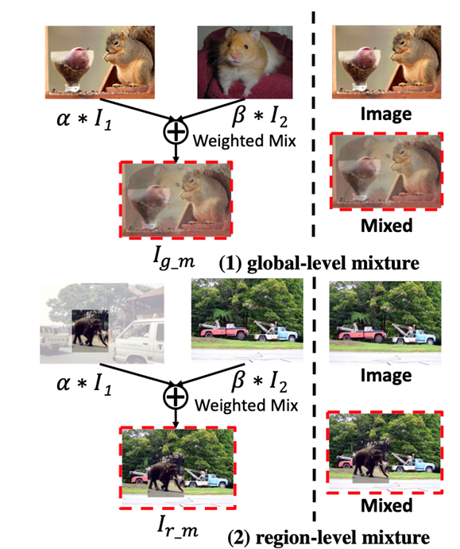
Self-Supervised –Data Augmentation Regularization
Un-Mix: Rethinking Image Mixtures for Unsupervised Visual Representation Learning
(SimCLR Contrastive Learning-- BYOL)
Paper
Mixup
CutMix

Slide 57
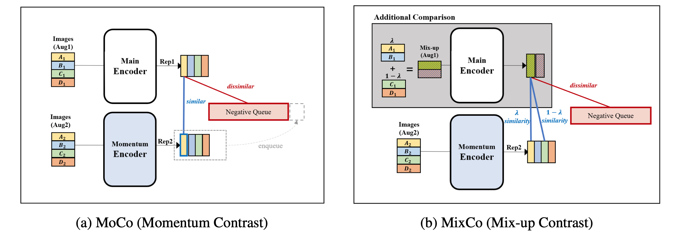
Self-Supervised –Data Augmentation Regularization
MixCo: Mix-up Contrastive Learning for Visual Representation (SimCLR Contrastive Learning)
Paper

Slide 58
1. What’s the different Data Augmentation Self-Supervised & Supervised

Slide 59
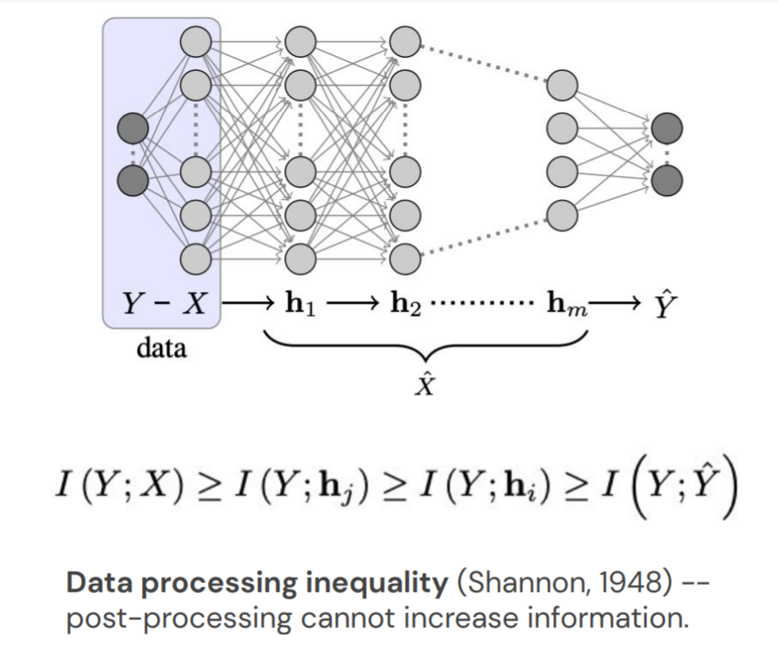
Supervised – Data Augmentation Core Values
“find a maximally compressed mapping of the input variable that preserves as much as possible the information on the output variable.”

Slide 60
Supervised – Data Augmentation Core Values
train a machine learning model, what you’re really doing is tuning its parameters such that it can map a particular input (say, an image) to some output (a label). Our optimization goal is to chase that sweet spot where our model’s loss is low, which happens when your parameters are tuned in the right way.

Slide 61
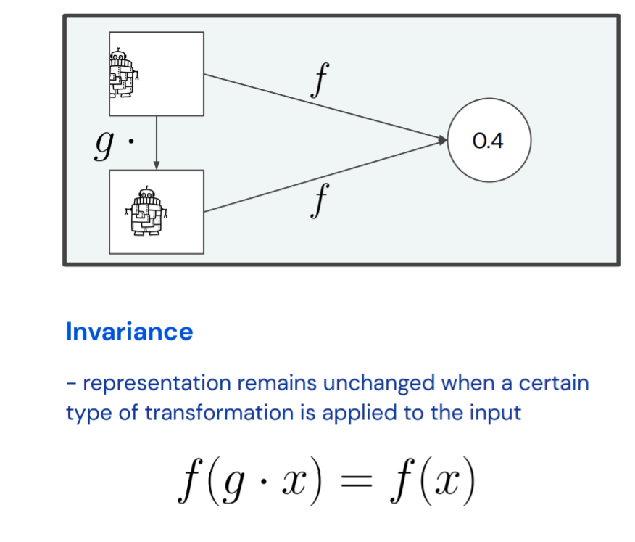
Self-Supervised Data Augmentation Core Values

Slide 62
3.
Proposed Multi-Augmentation Strategy.
(1. Define – 2.Policy – 3.Random)

Slide 63
Combination Data Augmentation Strategies
Supervised Data Augmentation
Self-Supervised Data Augmentation

Slide 64
Objectives
Finding the optimal strategy of Data Augmentation for Self-Supervised (Representation Learning)
Finding the efficient – Adaptable for different tasks domains in images (Natural, Cartoon, Medical )
Multi-Strategy Investigate (Representation Learning Differently)
(The effective of Multiple strategy on Representation Learning)
Robustness of Representation Learning with (Regularization)
+ Contrastive Learning (Positive – Negative) + Semi-Positive (Boosting Representation)
+ Contrastive Learning(Positive only) + Semi-Positive

Slide 65
Multi-Augmentation Strategy for Self-Supervised Learning
+ Augmentation Strategy
- Baseline Handcrafted Augmentation (SimCLR)
- Random Augmentation
- Auto Augmentation
- Fast Auto Augmentation
+ Multi-Crop View Augmentation Strategy
- Baseline Handcrafted Augmentation (SimCLR)
- Random Augmentation
- Auto Augmentation
- Fast Auto Augmentation
+ Augmentation Strategy + Augmentation_Regularization (Cutmix- Mixup)
- Input Mix
- Hidden layer Representation Mix

Slide 66
Handcrafted Baseline Strategy Data-Augmentation

Slide 67
Defined Strategy SimCLR Data-Augmentation
Apply Sequential 2 Transformations
Apply Single Transformation

Slide 68
Searching Optimal Strategy Data-Augmentation

Slide 69
Policy Strategy Auto Augmentation Data-Augmentation
Bayesian Optimization Supervised Learning

Slide 70
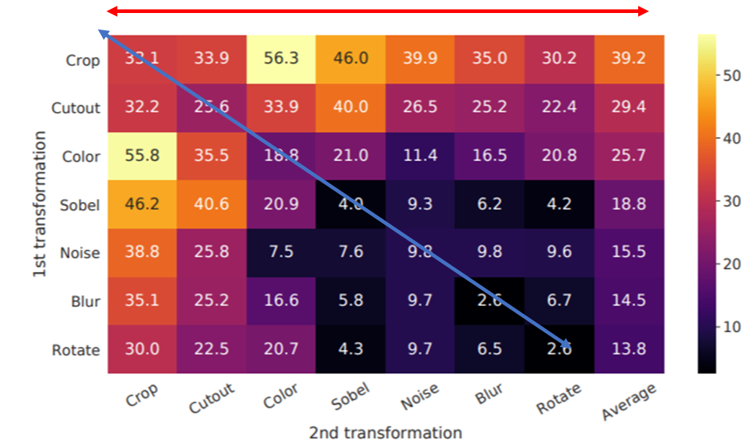
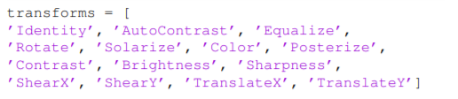
Comparing Data Augmentation Strategy
Defined Strategy
Random Search
Policy Bayesian optimization Search
Policy Strategy Auto Augmentation

Slide 71
Combination Data Augmentation Strategies
Supervised Data Augmentation
Self-Supervised Data Augmentation

Slide 72
Strategy Augmentation
-- Baseline Self-Supervised
+ (Cropping & Color Distortion)(Experiment in Progress)
-- Supervised Random Augmentation + Self
+ Random Augmentation + Cropping
+Random Augmentation + W/O Croping
-- Supervised Bayesian Searching(Data Augmentation Policy)
+ (Fast_AA, Fast_AA_Self-Supervised)
-- Supervised AutoAugmentation Strate
+ (Auto AA)

Slide 73
Contrastive Framework SSL 2 Views Augmentation

Slide 74
Contrastive --Framework SSL Multi-Views Augmentation

Slide 75
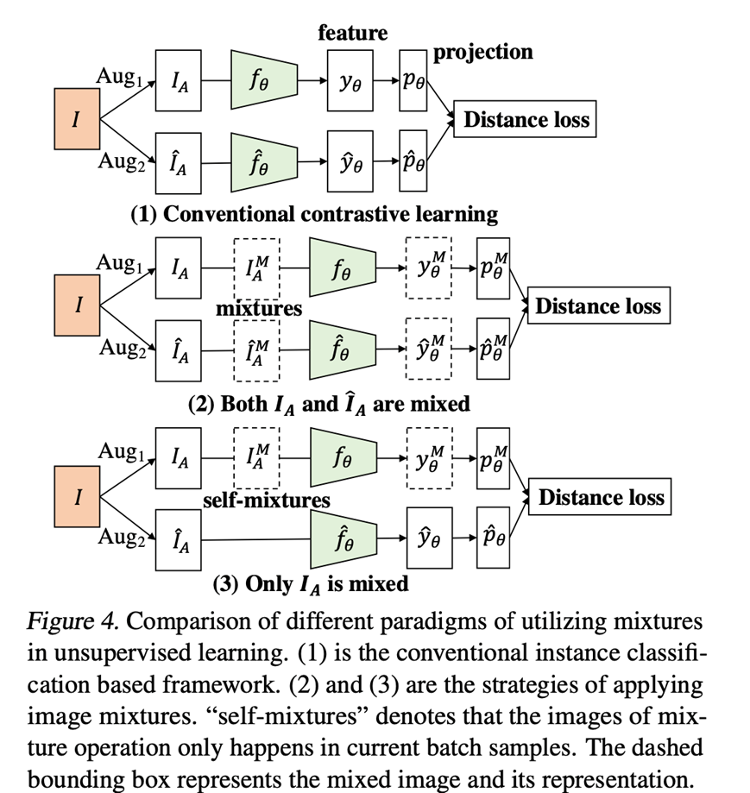
Strategy Augmentation 2 Views

Slide 76
Strategy Augmentation Multi Views

Slide 77
Multi-Strategies Augmentation – Regularization

Slide 78
Strategy Augmentation + Strong Regularization
Mixup
CutMix

Slide 79

Multi-Strategy Augmentation + Regularization (Mixup & CutMix)

Slide 80
Multi-Strategy Augmentation + Regularization (Mixup & CutMix) – Multi-Views

Slide 81
Order Emperical Studies Investigate

Slide 82
Order Augmentation + Regularization
Multi-Augmentation Strategy
Mixup

Slide 83
4.
Proposed method Implementation - Pipeline

Slide 84
Building End to End pipeline
Pipe line Section Clear
How to Design pipeline Complete
How to implement Eeach Section of the Pipeline
What is the most Crutial important in the pipeline
How many pepole Can work together on this Topic

Slide 85
Method Proposal Pipeline
Section 1
Section 2
Section 3
Dataset
ImageNet,
CoCo,
Heuristic Attention (Segmentation Masks)
Data Augmentation
Neural Net Architecture
Self-Supervised Learning Framework
Self-Training
Distillation Training
Evaluation Proposed Methods
Section 4
Section 5

Slide 86
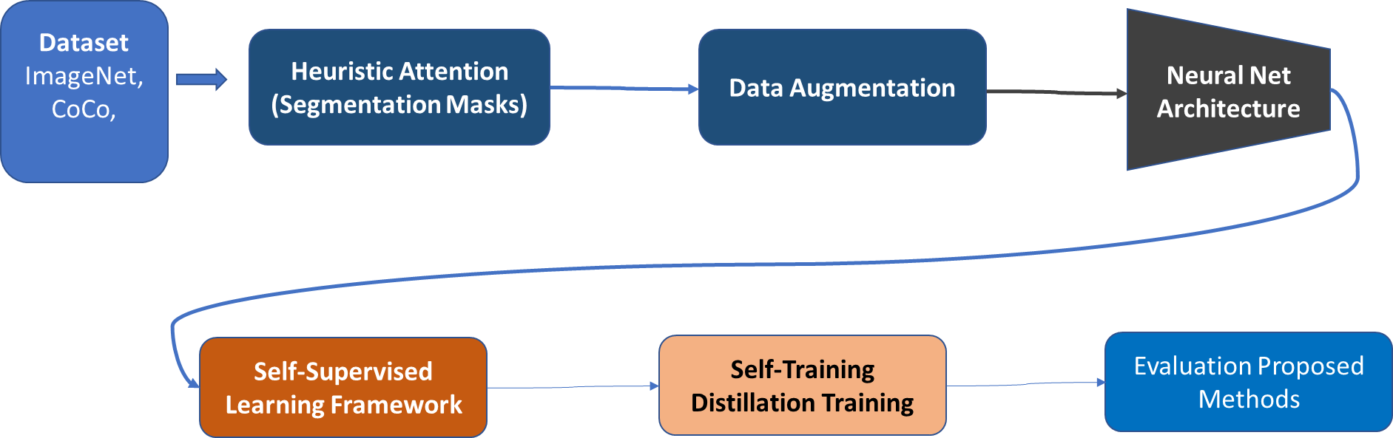





Study Proposed Pipeline
Dataset
Training Dataset
Image 1k ( 1M)
Image 21k (14M)
Finetuning and Testing on These dataset
Cityscape Dataset
Cityscape Dataset
Microsoft Dataset

Slide 87



Computer Vision Dataset
1k Classes 1.4 M images
Multi-Tasks Image Dataset (Object Detection, Segmentation, Img Classification)
300M JFT Google Image Classification Dataset
21K Classes 14 M images
400M Multi-Modalities Images-Text Pair Dataset

Slide 88


Study Proposed Pipeline
Augmented Different View

Slide 89
Study Proposed Pipeline
Augmented Different View
Fast Auto Augmentation
Policy Bayesian optimization Search

Slide 90
Study Proposed Pipeline
Augmented Different View
Random Augmentation

Slide 91


Study Proposed Pipeline
Neural Net Architecture
RegNet (Well design ConvNet Architecture Memory efficient-Fit GPUs- Larger parameter – Larger Batch_size training, Efficiency in speedup training)
RegNet Residual Block

Slide 92

Study Proposed Pipeline
Neural Net Architecture
Convolution-Transformer

Slide 93
5.
Proposed method – Schedule - Expected Result

Slide 94
Schedule File including Literature Review
And Implementation – Experiment
Writing Paper Journal
Working across the team

Slide 95
Study Proposed Pipeline
Dataset
ImageNet,
CoCo,
Heuristic Attention (Segmentation Masks)
Data Augmentation
Neural Net Architecture
Self-Supervised Learning Framework
Self-Training
Distillation Training
Evaluation Proposed Methods
Structure of Paper Proposal writing
Editing Paper with Experiment Result
Submit to
Submitting Paper Journal

Slide 96
Distributed Work Pipeline

Slide 97

Distributed Work Pipeline

Slide 98

Distributed Work Pipeline

Slide 99



Distributed Work Pipeline
Write Code – Building Project
Google Colab (GitHub platform– Update)
Tracking Experiment (Weight & Bias)

Slide 100
Distributed Work Pipeline
Rick
Structure of Paper Proposal writing
Editing Paper with Experiment Result
Submit to
Submitting Paper Journal

Slide 101
TimeLine Expected

Slide 102

Distributed Work Pipeline
Pipeline in PyTorch Framework
9/20 → 11/21 (2 Months)
1st Phase time-line
2-Weeks (10/15-11/01)
Data Augmentation Pipeline
+ AutoAugment
+ RandAugment
+ Baseline(SimCLR)
1,5 Weeks (9/20-9/30)
Prepare and Processing Dataset (ImageNet, CoCo, etc.)
Self-Supervised Pipeline
3-Weeks (11/01-11/21)
+ Convolution Architecture
+ Transformer
+ Conv_Transformer
3- 4 Weeks (10/01-11/01)
(Mask Generated)
Traditions → Deep Learning( Segmentation Mask) -- > Meta Pseudo)

Slide 103
Distributed Work Pipeline
Pipeline in Pytorch Framework
11/21 → 01/30 (1,5 Month)
2nd Phase time-line
2 Weeks (11/21-01/04)
Building Self-Supervised Framework
+ Contrastive – methods
+ None Contrastive
+ None Contrastive – Clustering assignments
1.5-Weeks (12/15-01/01)
Self-Training Framework Designed
+ Design the knowledge distillation techniques
1-Weeks (01/01-01/08)
+ Metrics for comparison with others papers
+ Result and Table Consideration

Slide 104

Distributed Work Pipeline
Completed Pipeline
Training Time ----> (Large Scale dataset – Google TPU -128 ImageNet 21k week Time)

Slide 105
Distributed Work Pipeline
Writing and Submitting → ??
Rick
Structure of Paper Proposal writing
Editing Paper with Experiment Result
Submit to
Submitting Paper Journal

